Slide 1
The path to using AIO in Postgres
Andres Freund
PostgreSQL Developer & Committer
Email: andres@anarazel.de
Email: andres.freund@microsoft.com
anarazel.de/talks/2023-10-04-pgconf-nyc-path-to-aio/path-to-aio.pdf

Slide 2
It’s Long

Slide 3
It’s Hard

Slide 4
Reads: synchronous, not cached
Client
Postgres
OS
Disk
Time

Slide 5
Reads: asynchronous, not cached
Client
Postgres
OS
Disk
Time

Slide 6
Reads: synchronous, OS cached
Client
Postgres
OS
Disk
Time

Slide 7
Reads: synchronous, postgres cached
Client
Postgres
OS
Disk
Time

Slide 8
Buffered read()
Application
Syscall
copy_to_user
Syscall
Userspace
Kernel
Page Cache
DMA
IRQ
IO
Drive

Slide 9
Direct IO (DIO) read()
Application
Syscall
DMA
Syscall
Userspace
Kernel
IO
IRQ
Drive

Slide 10
16: Bulk Relation Extension, Buffer Replacement
Infrastructure for multiple “in progress” Buffers
Buffer Replacement – “Get a free buffer when there are no free ones”
Relation Extension - “Making a table bigger”

Slide 13
16: “Add debug_io_direct setting for developer usage”
Can be set to data, wal, wal_init
NOT RECOMMENDED FOR PRODUCTION
“data”
  relation IO
  is disastrous for performance
“wal”
  can already show benefits, particularly with wal_sync_method=open_datasync
“wal_init”
  creation of new WAL files

Slide 14
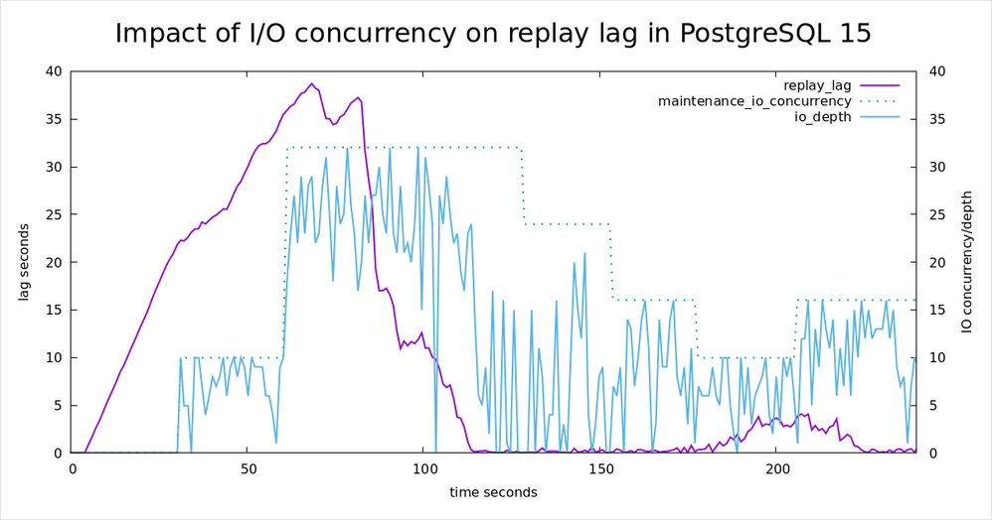
15: Recovery Prefetching (Thomas Munro)
https://techcommunity.microsoft.com/t5/azure-database-for-postgresql/reducing-replication-lag-with-io-concurrency-in-postgres-15/ba-p/3673169

Slide 15
17?: Streaming Read Abstraction
Simple interface for most read IO
No AIO, just “fadvise” style prefetching
Main Goal: Parallelize development
Minor Goal: Small performance gains
Convert some users to new interface
See
https://postgr.es/m/CA+hUKGJkOiOCa+mag4BF+zHo7qo=o9CFheB8=g6uT5TUm2gkvA@mail.gmail.com

Slide 16
17 ??: AIO infrastructure
io_method=(worker|io_uring|posix_aio)
goal: can use AIO infrastructure without loss of performance, even when no AIO support present, to avoid duplicating code
Not yet used

Slide 17
17 ?: sequential scans
Problem:
  Only use OS readahead
  Double Buffering
  Can get confused (skipped blocks, segments)
  Not guaranteed to be present
  OS readahead doesn't know workload / not aggressive enough
  Simple patch due to “streaming read” interface

Slide 20
17??: checkpointer, bgwriter
Throughput limited due to CPU overhead
Limited control over latency impact with buffered IO

Slide 22
18?: WAL writes
benefit #1: Do something else during WAL write / flush
  could get rid of bgwriter (often overloaded, not adaptive)
benefit #2: Multiple WAL flushes concurrently
  we have group commit
  but only one flush in progress
Hard, gains only very partially realized right now

Slide 24
18?: WAL writes
pgbench transaction: ~450 bytes
default WAL page size: 8kB
in-write page cannot be written again before completion
Problem: to-be-flushed-page is rarely full
Solution (?): optionally pad partial pages

Slide 27
17?/18?: VACUUM
improved read performance
improved *write* performance
  due to asynchronous WAL flushing
  due to DIO
better control over latency effects
 | high lat cloud disk | lower lat cloud disk
master | 94.673 s | 33.37 s
aio | 12.349 s | 7.737 s

Slide 28
17, 18: Other working AIO conversions
SyncDataDirectory()
Bitmap heap scans

Slide 29
Potential future AIO users
various index scans
  Tomas Vondra is working on some bits
More vacuuming
Temp table support
More everything
lower-level operations
  create database
  vacuum full
  on startup cleanups
  filesystem directory iteration

Slide 30
Thanks!
Colleagues working with me on this
  David, Melanie, Thomas and others
Others working on related important pieces
  Tomas Vondra is working index prefetching
  Bharath Rupireddy is working feelding walsender from buffers
  ...
github.com/anarazel/postgres/tree/aio
http://wiki.postgresql.org/wiki/AIO

